Slide 1




MICROPROCESSOR
KCS 403
UNIT -II
TOPICS
Pin diagram and internal architecture of 8085 microprocessor, registers, ALU, Control & status ,interrupt and machine cycle. Instruction sets. Addressing modes. Instruction formats Instruction Classification: data transfer, arithmetic operations, logical operations, branching operations, machine control and assembler directives
Jyoti Guglani
Department of Computer Science & Engineering
IMS ENGINEERING COLLEGE
Dr. A.P.J. Abdul Kalam Technical University,
Lucknow

Slide 2
8085 Microprocessor
The 8085 microprocessor is an 8-bit general purpose processor that can deal with the memory of 64K Byte. This microprocessor consists of 40-pins as well as works with +5V power supply. This processor can be work at a 3MHz of maximum frequency.
The 40 pins of the microprocessor can be divided into six groups such as address bus, data bus, control signals & status signals; power supply & frequency, externally started signals and serial input/output ports

Slide 3
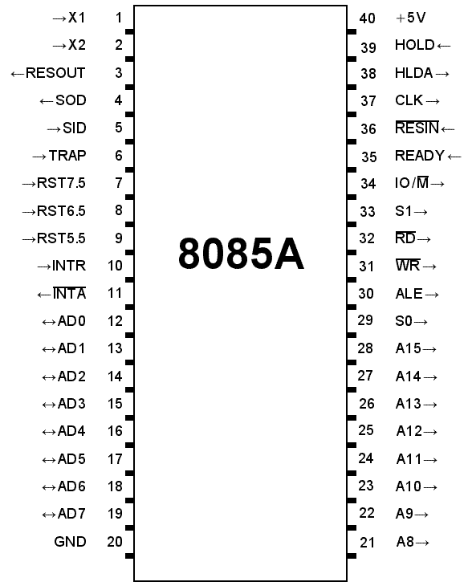

Slide 4
Address Bus (A8-A15)
The address bus pins are ranges from A8 to A15 and these are mainly applicable to the most considerable memory address bit.
Address Bus (or) Data Bus (AD0-AD7)
The address bus pins or data bus pins are ranges from AD0 to AD7, and these pins are applicable for LSB (least significant bits) of the address bus in the primary apparatus CLK cycle as well as employed as a data bus for second clock cycle & third clock cycle. A CLK cycle can be designed as, the time in use among two oscillator’s nearby pulses, or simply it can refer to zero volts. Here the first clock is the primary transition of pulse ranges from 0V to 5V & then reaches back to 0V.
Address Latch Enable (ALE)
Basically, ALE assists in de-multiplexing the data bus as well as low order address. This will go high throughout the primary clock cycle as well as allows the address bits with low order. The address bus with low order is added for memory otherwise any exterior latch.
Status Signal (IO/M)
The status signal IO/M resolves whether the address is intended for memory or input/output. When the address is high then the address of the address bus is used for the devices of input/output devices. When the address is low then the address of the address bus is used for the memory.
Status Signals (S0-S1)
The status signals S0, S1 gives different functions as well as status based on their status.
When the S0, S1 are 01 then the operation will be HALT.
the S0, S1 is 10 then the operation will be WRITE
When the S0, S1 is 10 then the operation will be READ
When the S0, S1 are 11 then the operation will be FETCH

Slide 5
Active Low Signal (RD)
The RD is an energetic low signal and an operation is executed whenever the indication goes small, and it is used for controlling the microprocessor READ operation. When RD pin goes small then the 8085 microprocessor understands the information from I/O device or memory.
Active Low Signal (WR)
This is an energetic low signal, and it controls the microprocessor’s write operations. Whenever WR pin goes small, then the information will be written to the I/O device or memory.
READY
The READY pin is employed with the 8085 microprocessor for ensuring whether a device is set for accepting or transferring data. A device may be an A/D converter or LCD display, etc. These devices are associated with the 8085 microprocessor with the READY-pin. When this pin is high, the device is prepared for transferring the information, if it is not then the microprocessor stays until this pin goes high.
HOLD
The HOLD pin specifies when any device is demanding the employ of address as well as a data bus. The two devices are LCD as well as A/D converter. Assume that if A/D converter is employing the address bus as well as a data bus. When LCD desires the utilize of both the buses by providing HOLD signal, subsequently the microprocessor transmits the control signal toward the LCD after that the existing cycle will be ended. When the LCD procedure is over, then the control signal is transmitted reverse to A/D converter.
HLDA
This is the response signal of HOLD, and it specifies whether this signal is obtained or not obtained. After the implementation of HOLD demand, this signal will go low.

Slide 6
INTR
This is an interrupt signal, and the priority of this among the interrupts is low. This signal can be allowed or not allowed by the software. When INTR pin goes high then the 8085 microprocessor completes the instruction of current which is being executed and then recognizes the INTR signal and progresses it.
INTA
When the 8085 microprocessor gets an interrupt signal, then it should be recognized. This will be done by INTA. As a result, when the interrupt will be obtained then INTA will go high.
RST 5.5, RST 6.5, RST 7.5
These pins are the restart maskable interrupts or Vectored Interrupts, used to insert an inner restart function repeatedly. All these interrupts are maskable, they can be allowed or not allowed by using programs.
TRAP
Along with the 8085 microprocessor interrupts, TRAP is a non-maskable interrupt, and it doesn’t allow or stopped by a program. TRAP has the maximum precedence between the interrupts. The priority order from maximum to low includes TRAP, RST 5.5, RST 6.5, RST 7.5, and INTR.
RESET IN
RESET IN pin is used to reset the program counter toward zero and rearranges interrupt enable as well as HLDA flip-flops (FFs). The central processing unit is detained in RST condition till this pin is high. But the registers as well as flags won’t get damaged apart from instruction register.
RST (RESET) OUT
RESET OUT pin specifies that the central processing unit has been rearranged with RST IN.
X1 X2 X1, X2 terminals that are associated with the exterior oscillator for generating the required as well as appropriate operation of a clock.
CLK
Sometimes it is compulsory to generate CLK o/PS from 8085 microprocessors so they can be used in favor of other peripherals or else other digital integrated circuits. This is offered with CLK pin. Its frequency is continually similar because the frequency at which the microprocessor works.
SID This is a serial i/p data, and the information on this pin is uploaded into the 7th-bit of the accumulator while RIM (Read Interrupt Mask) instruction is performed. RIM verifies the interrupt whether it is covered or not covered.
SOD This is the serial o/p data, and the data on this pin sends its output toward the 7th-bit of the accumulator whenever an instruction of SIM is performed.
VSS and VCC VSS is a ground pin whereas Vcc is +5v pin.

Slide 7
MULTIPLEXING / DEMULTIPLEXING OF ADDRESS / DATA LINES
The data bus and the low order address bus on the 8085 microprocessor are multiplexed with each other. This allows 8 pins to be used where 16 would normally be required. The hardware interface is required to demultiplex the bus by latching the low order address in the first T cycle, on the falling edge of ALE.
The address bus is multiplexed in 8085. The multiplexing is done with the help of ALE signal. ALE stands for address latch enable. When ALE is High (Logic 1) : Upper address lines (line 15-8) and Lower address lines (line 7-0) combinely holds the 16 bits of the address. When ALE is Low (Logic 0) : Upper address lines (line 15-8) holds the upper 8 bit address & Lower address lines (line 7-0) holds the "8 bit DATA"
Multiplexing is used to reduce the number of pins of 8085, which otherwise would have been a 48 pin chip. But because of multiplexing, external hardware is required to demultiplex the lower byte address cum data bus.
The Pin no= 30 of 8085 is the ALE pin which stands for ‘Address Latch Enable’. ALE signal is used to demultiplex the lower order address bus (AD0 – AD7).
Pins 12 to 19 of 8085 are AD0 – AD7 which is the multiplexed address-data bus. Multiplexing is done to reduce the number of pins of 8085.
Lower byte of address (A0 – A7) are available from AD0 – AD7 (pins 12 to 19) during T1 of machine cycle. But the lower byte of address (A0 – A7), along with the upper byte A8 – A15 (pins 21 to 28) must be available during T2 and rest of the machine cycle to access memory location or I/O ports.
Now ALE signal goes high at the beginning of T1 of each machine cycle and goes low at the end of T1 and remains low during the rest of the machine cycle. This high to low transition of ALE signal at the end of T1 is used to latch the lower order address byte (A0 – A7) by the latch IC 74LS373, so that the lower byte A0 – A7 is continued to be available till the end of the machine cycle. The situation is explained in the following

Slide 8
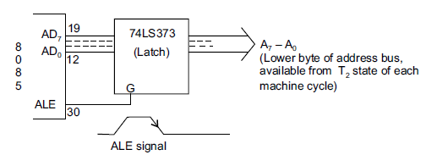
Now ALE signal goes high at the beginning of T1 of each machine cycle and goes low at the end of T1 and remains low during the rest of the machine cycle. This high to low transition of ALE signal at the end of T1 is used to latch the lower order address byte (A0 – A7) by the latch IC 74LS373, so that the lower byte A0 – A7 is continued to be available till the end of the machine cycle. The situation is explained in the following figure:

Slide 9
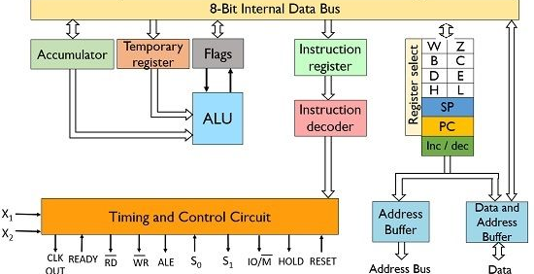
Block Diagram OF 8085 MICROPROCESSOR

Slide 10
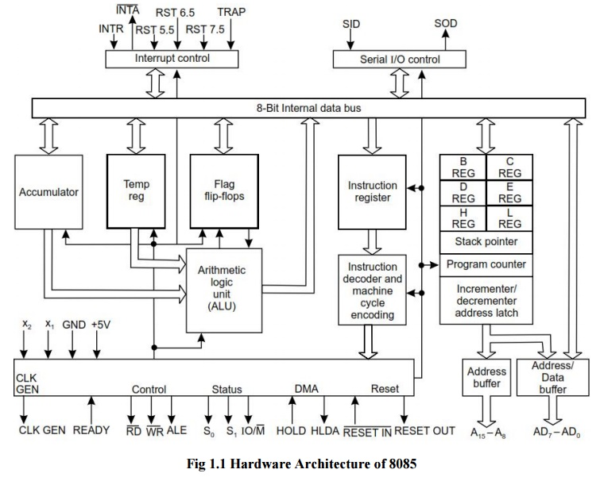
Architecture of 8085 Microprocessor

Slide 11
Functional Units of 8085:
1. Registers: These are nothing but set of flip flops. These are basically used to hold (store) the data.
General purpose registers– 8085 microprocessors contain 6 general purpose registers that are present inside the microprocessor and stores 8-bit data in order to execute a program.
These general purpose registers are B, C, D, E, H and L. These registers can be combined to form pairs – BC, DE and HL in order to execute the 16-bit operation.
These are programmable registers, that means these registers are accessed by the programmer to insert and transfer the data by making use of instructions.
Temporary registers: These registers are used by the ALU to store the data on temporary basis and these are not accessed by the programmer. These are of 2 types:
Temporary data register – It is an 8-bit register that holds the operand and provides it to the ALU for program execution. Also, the immediate results are stored by the ALU in this register.
W and Z register – These registers are also used to hold the temporary values. It is used by the control section of the microprocessor so as to store the data during operations.
2. Program Counter (PC): It is basically a special purpose register that is used to store the memory location of the instruction to be performed. As it is clear that in order to fetch an instruction from the memory the microprocessor needs to know about its address.
It is a 16-bit register as it stores address. This register is used by the microprocessor to line up the instructions that are to be executed in a sequential manner.
It functions in such a way that it fetches the opcode from one memory location and simultaneously get incremented by the next memory location. Thus, it provides sequencing of the program to be executed.

Slide 12
3. Stack Pointer (SP): It is also a 16-bit register and is a part of memory. The data is stored in the stack in serial format and stack pointer generally stores the address of the last data element stored in the stack. Thus the stack is based on LIFO.
Whenever a new data is added in the stack, then the stack pointer starts pointing towards the very next memory location.
As against, when a data element is removed from the stack, then the stack pointer points to previous occupied memory location.
4. Accumulator: It is an 8-bit register that stores the result of the operation performed by the ALU. It is also known as register A.
5. Flags: Flag register basically holds the status of the current result generated by the ALU and not the actually generated result. Thus we can say it is used to test the data conditions.
8085 has 5 flags that shows 5 different data conditions. These are carry, sign, zero, parity and auxiliary carry flags. However, the mostly used are: sign, carry and zero.
Machine cycle The time required for the microprocessor to access memory or an IO device either for a read operation or a write operation is called a machine cycle.

Slide 13
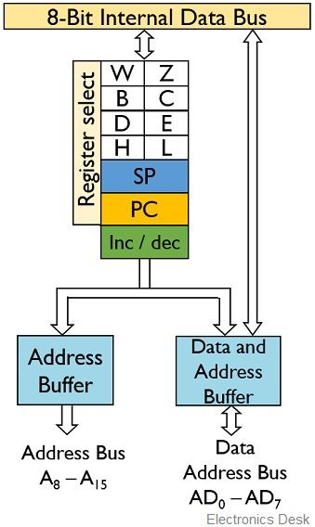
Working of 8085 Microprocessor
Also, in order to execute an instruction, it first needs to be fetched then decoded and then executed. And in order to fetch an instruction, firstly the address of the instruction must be known.
The address of the instruction is present in the program counter. This address is then placed on the 16-bit address bus and is then forwarded towards the memory. From the memory, the instruction present at that particular memory location is fetched through the 8-bit data bus.

Slide 14
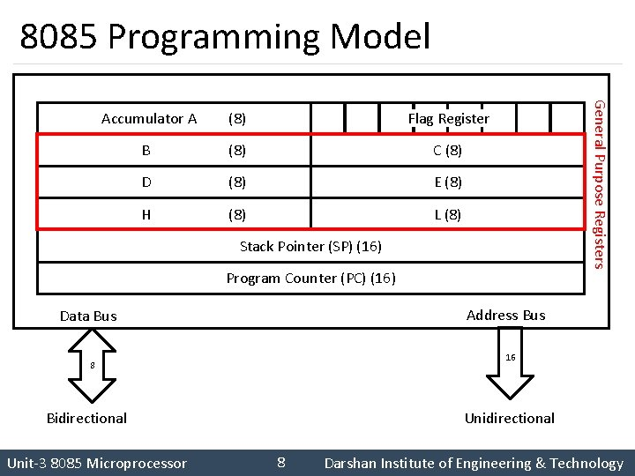
Programming Model of 8085

Slide 15
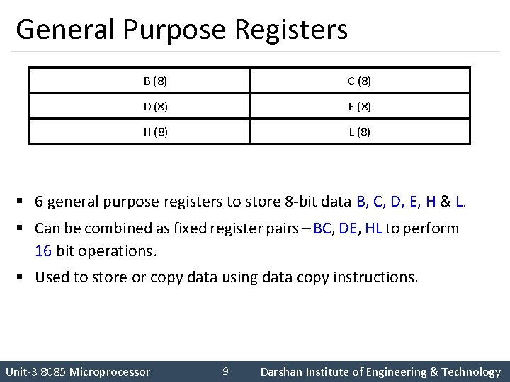

Slide 16
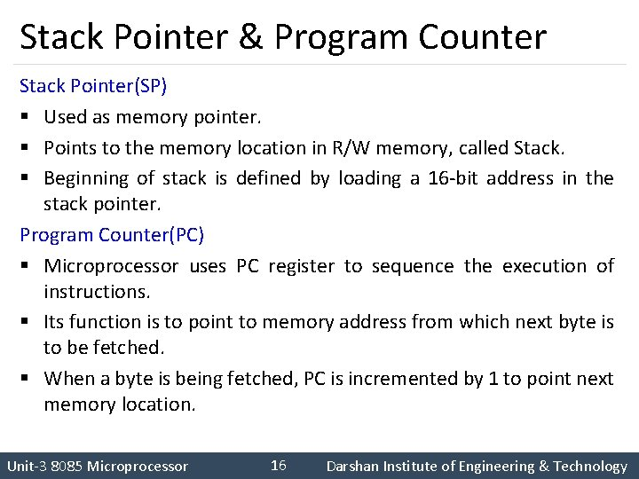

Slide 17
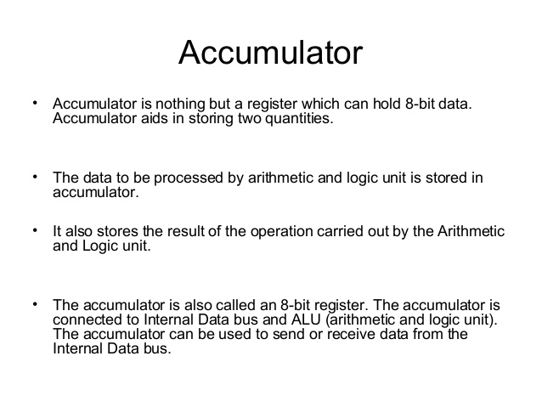

Slide 18
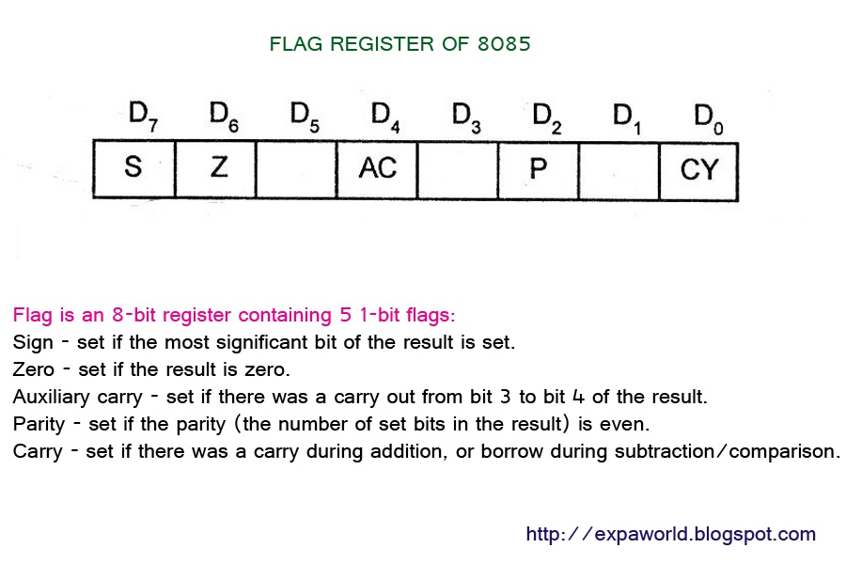

Slide 19
Interrupts in 8085
When microprocessor receives interrupt signals, it sends an acknowledgement (INTA) to the peripheral which is requesting for its service.
Hardware and Software Interrupts –
When microprocessors receive interrupt signals through pins (hardware) of microprocessor, they are known as Hardware Interrupts. There are 5 Hardware Interrupts in 8085 microprocessor. They are – INTR, RST 7.5, RST 6.5, RST 5.5, TRAP
Software Interrupts are those which are inserted in between the program which means these are mnemonics of microprocessor. There are 8 software interrupts in 8085 microprocessor. They are – RST 0, RST 1, RST 2, RST 3, RST 4, RST 5, RST 6, RST 7.

Slide 20
Vectored and Non-Vectored Interrupts – Vectored Interrupts are those which have fixed vector address (starting address of sub-routine) and after executing these, program control is transferred to that address. Vector Addresses are calculated by the formula 8 * TYPE
INTERRUPT | VECTOR ADDRESS
TRAP (RST 4.5) | 24 H
RST 5.5 | 2C H
RST 6.5 | 34 H
RST 7.5 | 3C H
INTERRUPT | VECTOR ADDRESS
RST 0 | 00 H
RST 1 | 08 H
RST 2 | 10 H
RST 3 | 18 H
RST 4 | 20 H
RST 5 | 28 H
RST 6 | 30 H
RST 7 | 38 H
For Software interrupts vector addresses are given by:

Slide 21
Non-Vectored Interrupts are those in which vector address is not predefined. The interrupting device gives the address of sub-routine for these interrupts. INTR is the only non-vectored interrupt in 8085 microprocessor.
Maskable and Non-Maskable Interrupts –
Maskable Interrupts are those which can be disabled or ignored by the microprocessor. These interrupts are either edge-triggered or level-triggered, so they can be disabled. INTR, RST 7.5, RST 6.5, RST 5.5 are maskable interrupts in 8085 microprocessor.
Non-Maskable Interrupts are those which cannot be disabled or ignored by microprocessor. TRAP is a non-maskable interrupt. It consists of both level as well as edge triggering and is used in critical power failure conditions.

Slide 22
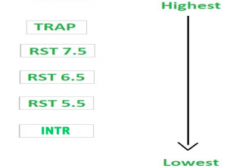
Priority of Interrupts – When microprocessor receives multiple interrupt requests simultaneously, it will execute the interrupt service request (ISR) according to the priority of the interrupts.

Slide 23
Instruction for Interrupts –
Enable Interrupt (EI) – The interrupt enable flip-flop is set and all interrupts are enabled following the execution of next instruction followed by EI. No flags are affected. After a system reset, the interrupt enable flip-flop is reset, thus disabling the interrupts. This instruction is necessary to enable the interrupts again (except TRAP).
Disable Interrupt (DI) – This instruction is used to reset the value of enable flip-flop hence disabling all the interrupts. No flags are affected by this instruction.
Set Interrupt Mask (SIM) – It is used to implement the hardware interrupts (RST 7.5, RST 6.5, RST 5.5) by setting various bits to form masks or generate output data via the Serial Output Data (SOD) line.
4. Read Interrupt Mask (RIM) – This instruction is used to read the status of the hardware interrupts (RST 7.5, RST 6.5, RST 5.5) by loading into the A register a byte which defines the condition of the mask bits for the interrupts. It also reads the condition of SID (Serial Input Data) bit on the microprocessor.

Slide 24
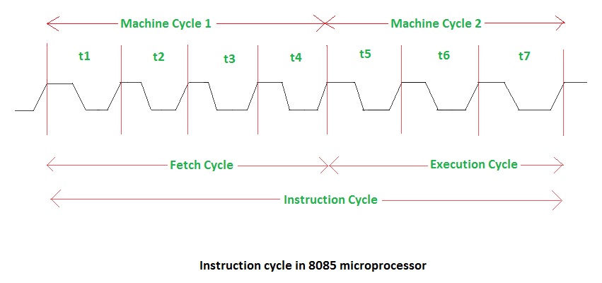
Instruction Cycle and Machine Cycle
Time required to execute and fetch an entire instruction is called instruction cycle. It consists:
Fetch cycle – The next instruction is fetched by the address stored in program counter (PC) and then stored in the instruction register.
Decode instruction – Decoder interprets the encoded instruction from instruction register.
Execution cycle – consists memory read (MR), memory write (MW), input output read (IOR) and input output write (IOW)
Machine Cycle: The time required by the microprocessor to complete an operation of accessing memory or input/output devices is called machine cycle. One time period of frequency of microprocessor is called t-state. A t-state is measured from the falling edge of one clock pulse to the falling edge of the next clock pulse. Fetch cycle takes four t-states and execution cycle takes three t-states.

Slide 25
Types of Addressing Modes
The different ways in which the location of the operand is specified in an instruction are referred to as addressing modes
Immediate Addressing
Register Addressing
Direct Addressing
Register Indirect Addressing
Implied Addressing Mode

Slide 26
Immediate Addressing Mode- In immediate addressing mode the source operand is always data. If the data is 8-bit, then the instruction will be of 2 bytes, if the data is of 16-bit then the instruction will be of 3 bytes.
ADD 5 (Add content of register A with data 5)
MUL 4 (Multiply data of A register with 4)
Register Addressing Mode –
In register addressing mode, the data to be operated is available inside the register(s) and register(s) is(are) operands. Therefore the operation is performed within various registers of the microprocessor.
MOV A, B (move the contents of register B to register A)
ADD B (add contents of registers A and B and store the result in register A)
Direct Addressing Mode –
In direct addressing mode, the data to be operated is available inside a memory location and that memory location is directly specified as an operand. The operand is directly available in the instruction itself.
LDA 2050 (load the contents of memory location into accumulator A)

Slide 27
Register Indirect Addressing Mode –
In register indirect addressing mode, the data to be operated is available inside a memory location and that memory location is indirectly specified by a register pair.
Examples: MOV A, M (move the contents of the memory location pointed by the H-L pair to the accumulator)
Implied/Implicit Addressing Mode – In implied/implicit addressing mode the operand is hidden and the data to be operated is available in the instruction itself.
CMA (finds and stores the 1’s complement of the contains of accumulator A in A)
RRC (rotate accumulator A right by one bit)
RLC (rotate accumulator A left by one bit)
HALT (Terminate the program)

Slide 28
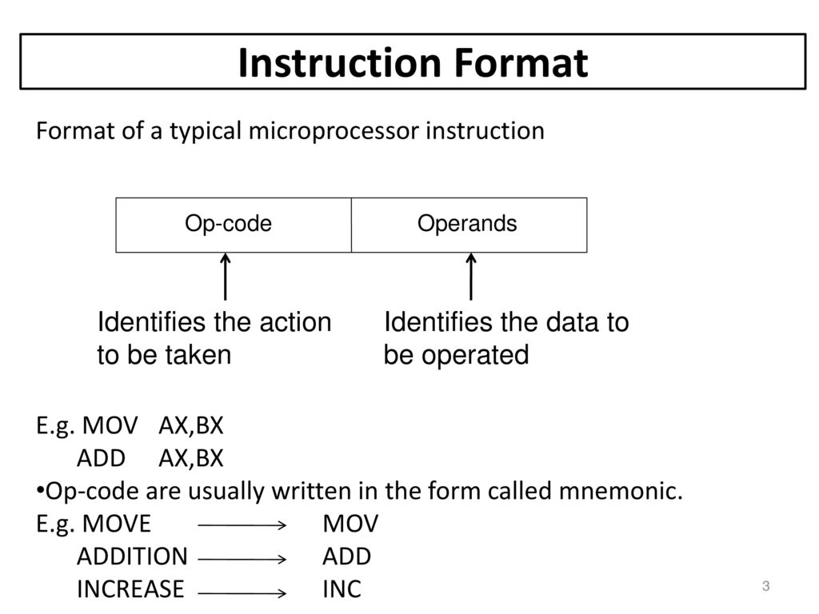
INSTRUCTION FORMAT

Slide 29
Instruction Set of 8085 Microprocessor
A group of instructions that are supported by the 8085 microprocessor is known to be the instruction set of 8085 microprocessor. 8085 is designed to have 5 functional categories of the instruction set:
1. Data Transfer Instruction
These instructions are used by the microprocessor in order to transfer the data from one location to another. More specifically, it helps in transferring the data from source operand to destination operand, without making any changes in the source data.
2. Arithmetic Instruction
This instruction set allows arithmetic operations to be performed over the data in memory and register inside the 8085 microprocessor.
3. Logical Instruction
These instructions are used to perform logical or Boolean operations over the data present in either register or memory. The logical instructions modify the flag bits according to the operation performed.

Slide 30
Instruction Set of 8085
3. Branching Instruction
These instructions are used in order to switch or transfer the control of the microprocessor from one position to another. More specifically we can say, it changes the general sequential flow.
4. Control Instruction
As the name itself is suggesting that these instructions are used to control the operations of the microprocessor

Slide 31
THANK YOU
STUDENTS
Take Care and Be Safe

